Slide 1
Vision for Creating a World-Class Department of Agricultural Education, Communications, and Leadership
Dr. Jonathan Ulmer
Professor of Agricultural Education
Kansas State University

Slide 2



Experience in Academia

Slide 3
Professor
Associate Professor
Faculty Fellow
Teaching Coordinator

Slide 4
Associate Professor
Assistant Professor
STEM-CORE Director

Slide 5
Professional Development Specialist

Slide 6

Experience in Agricultural Education

Slide 7



Educational Experience

Slide 8
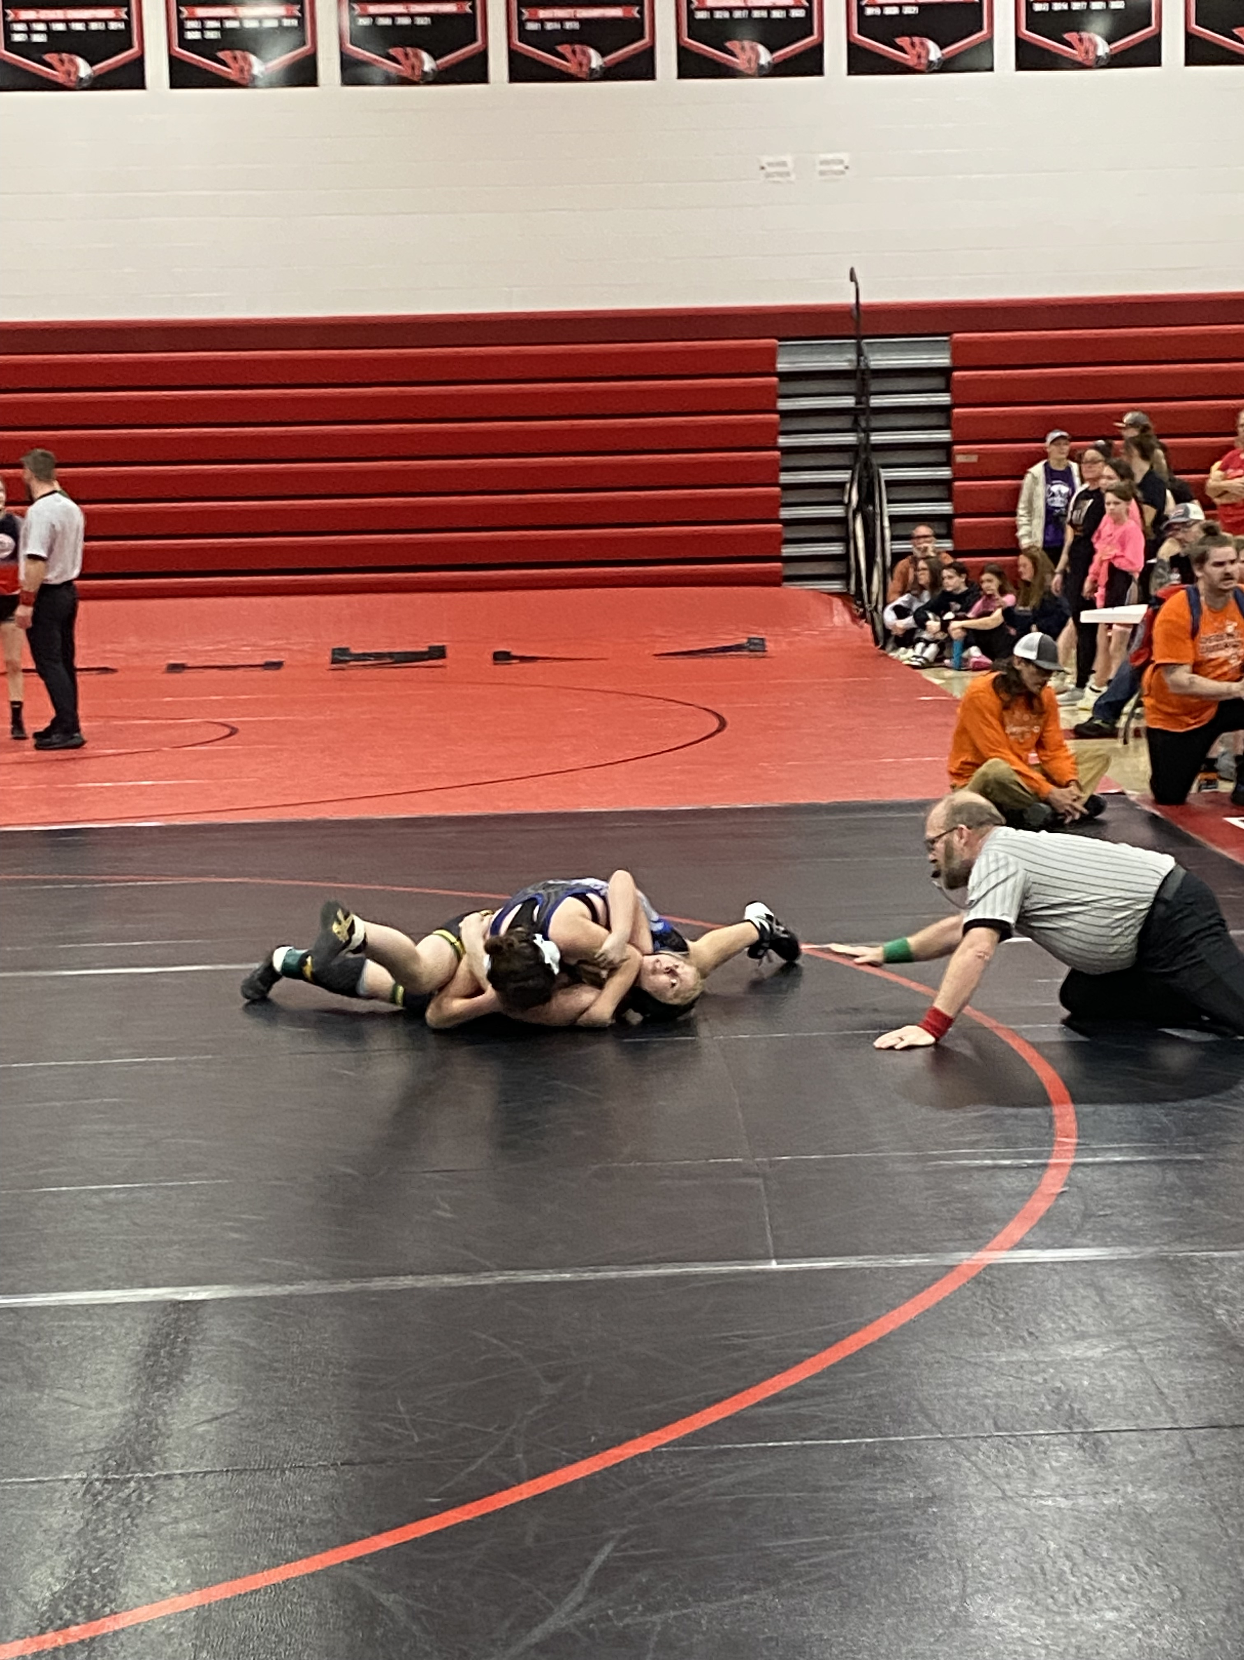
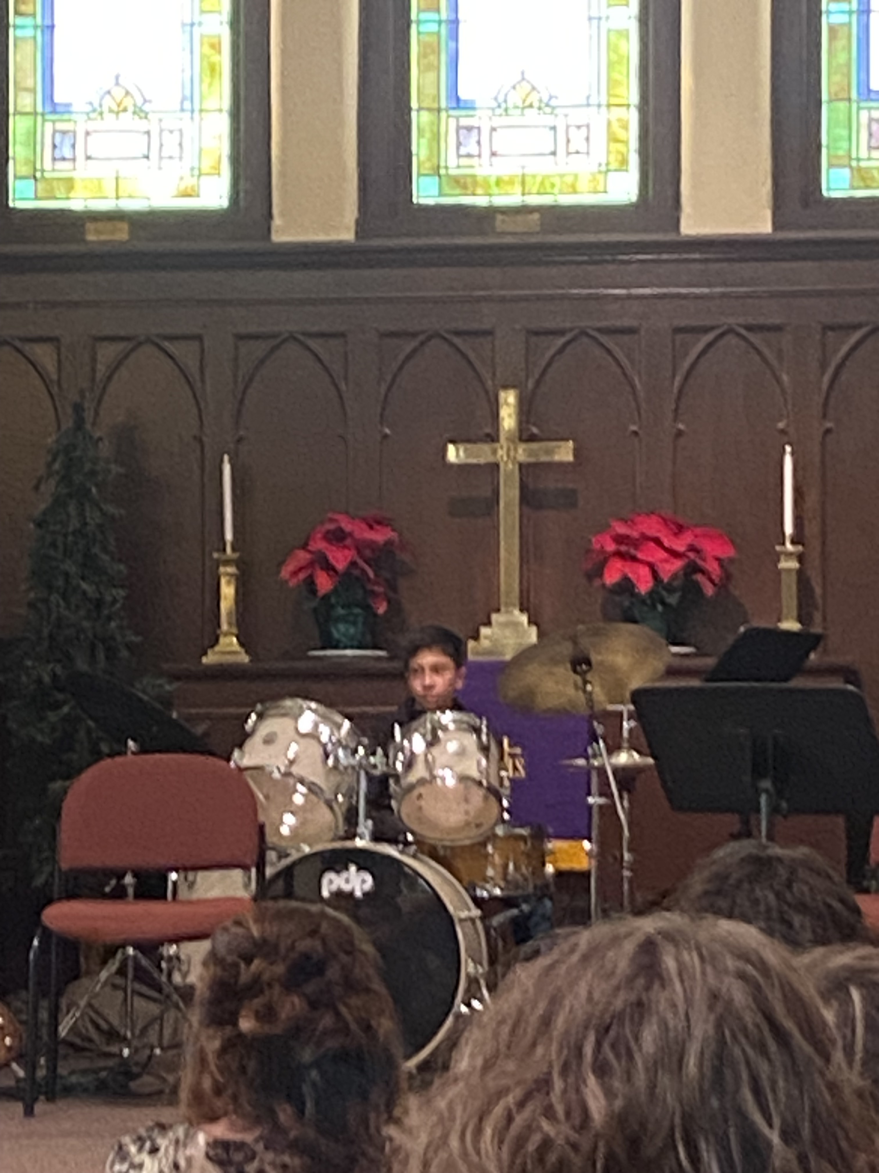
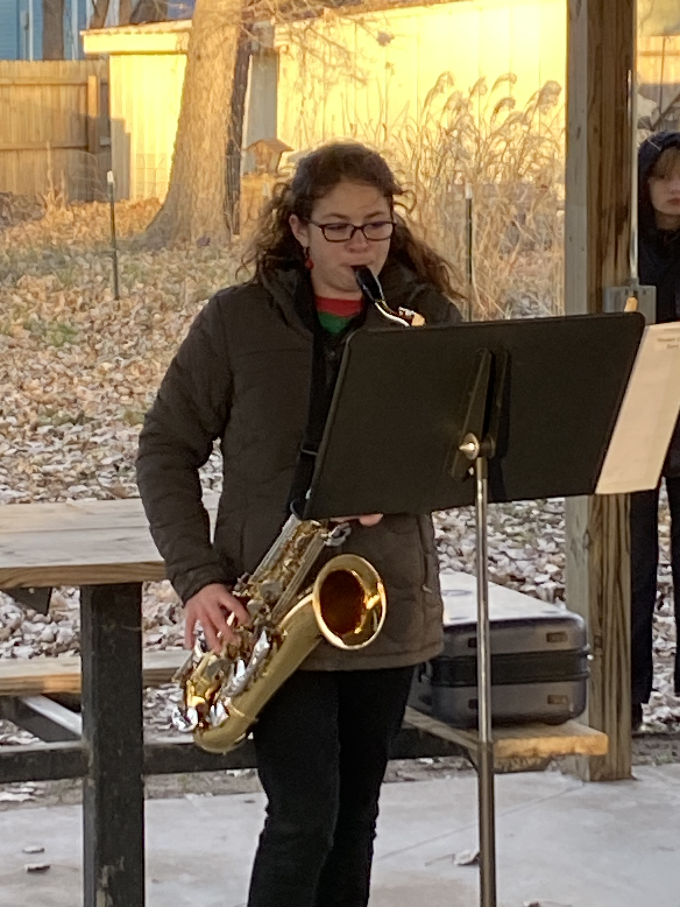
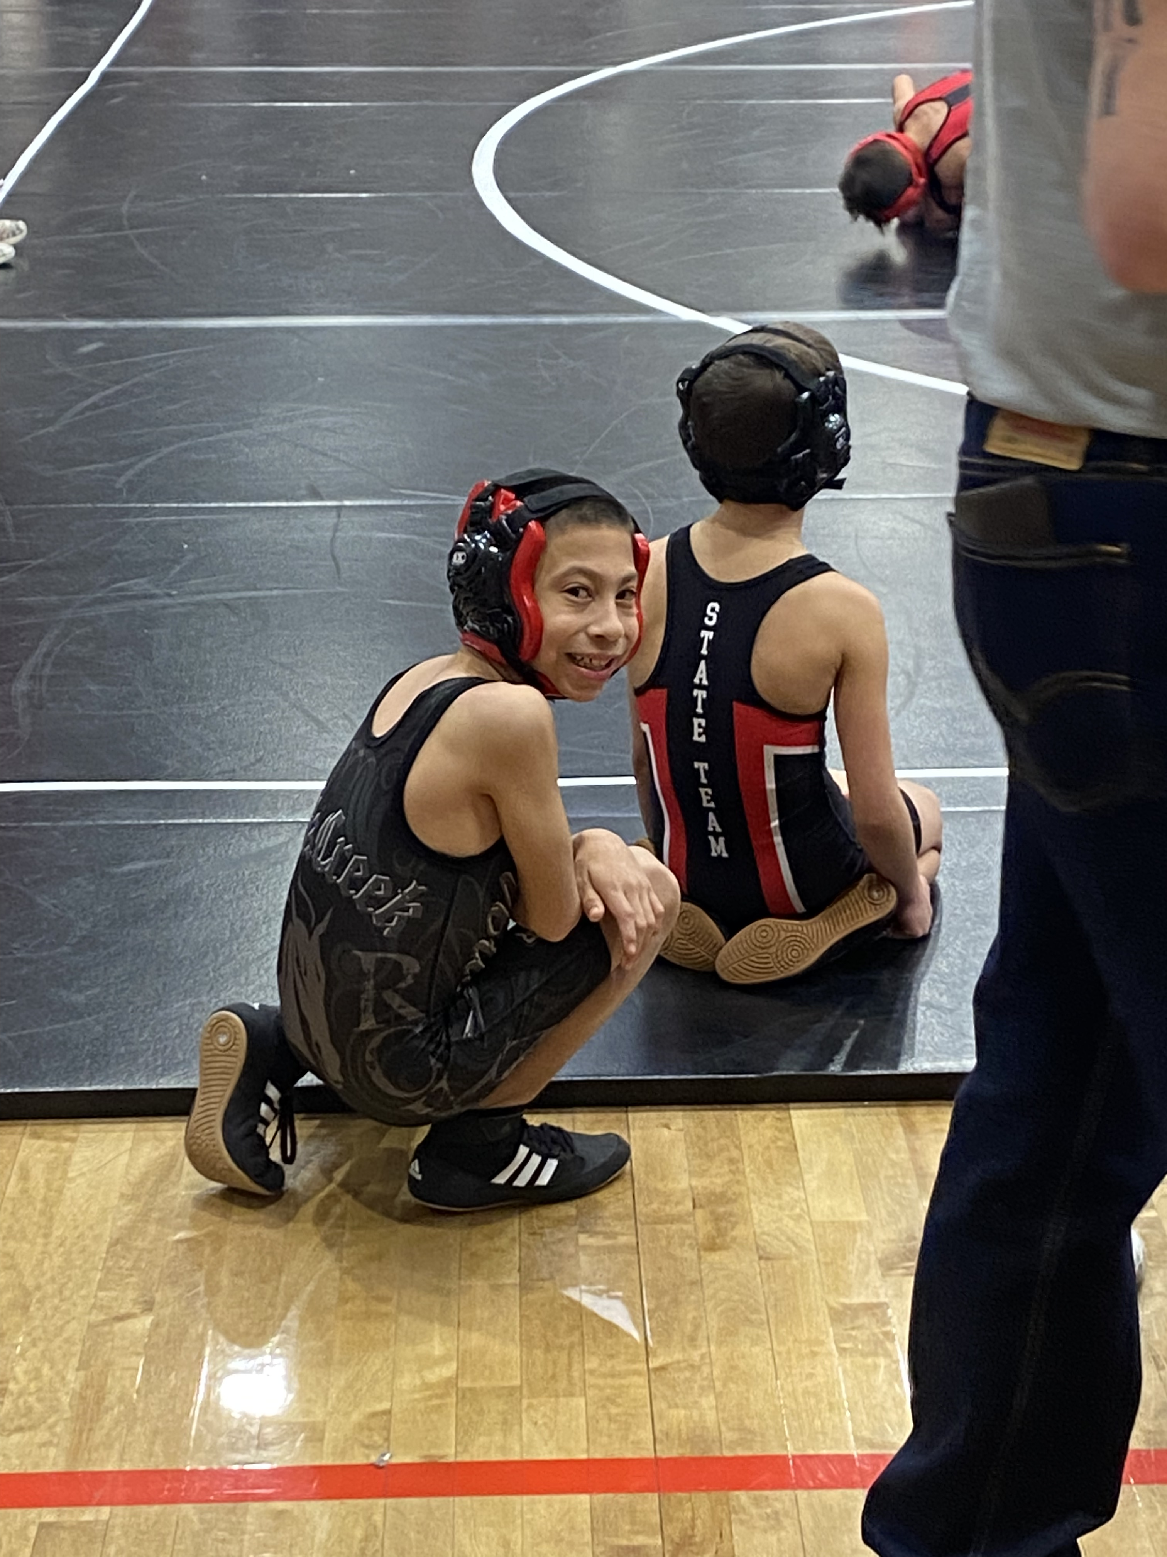
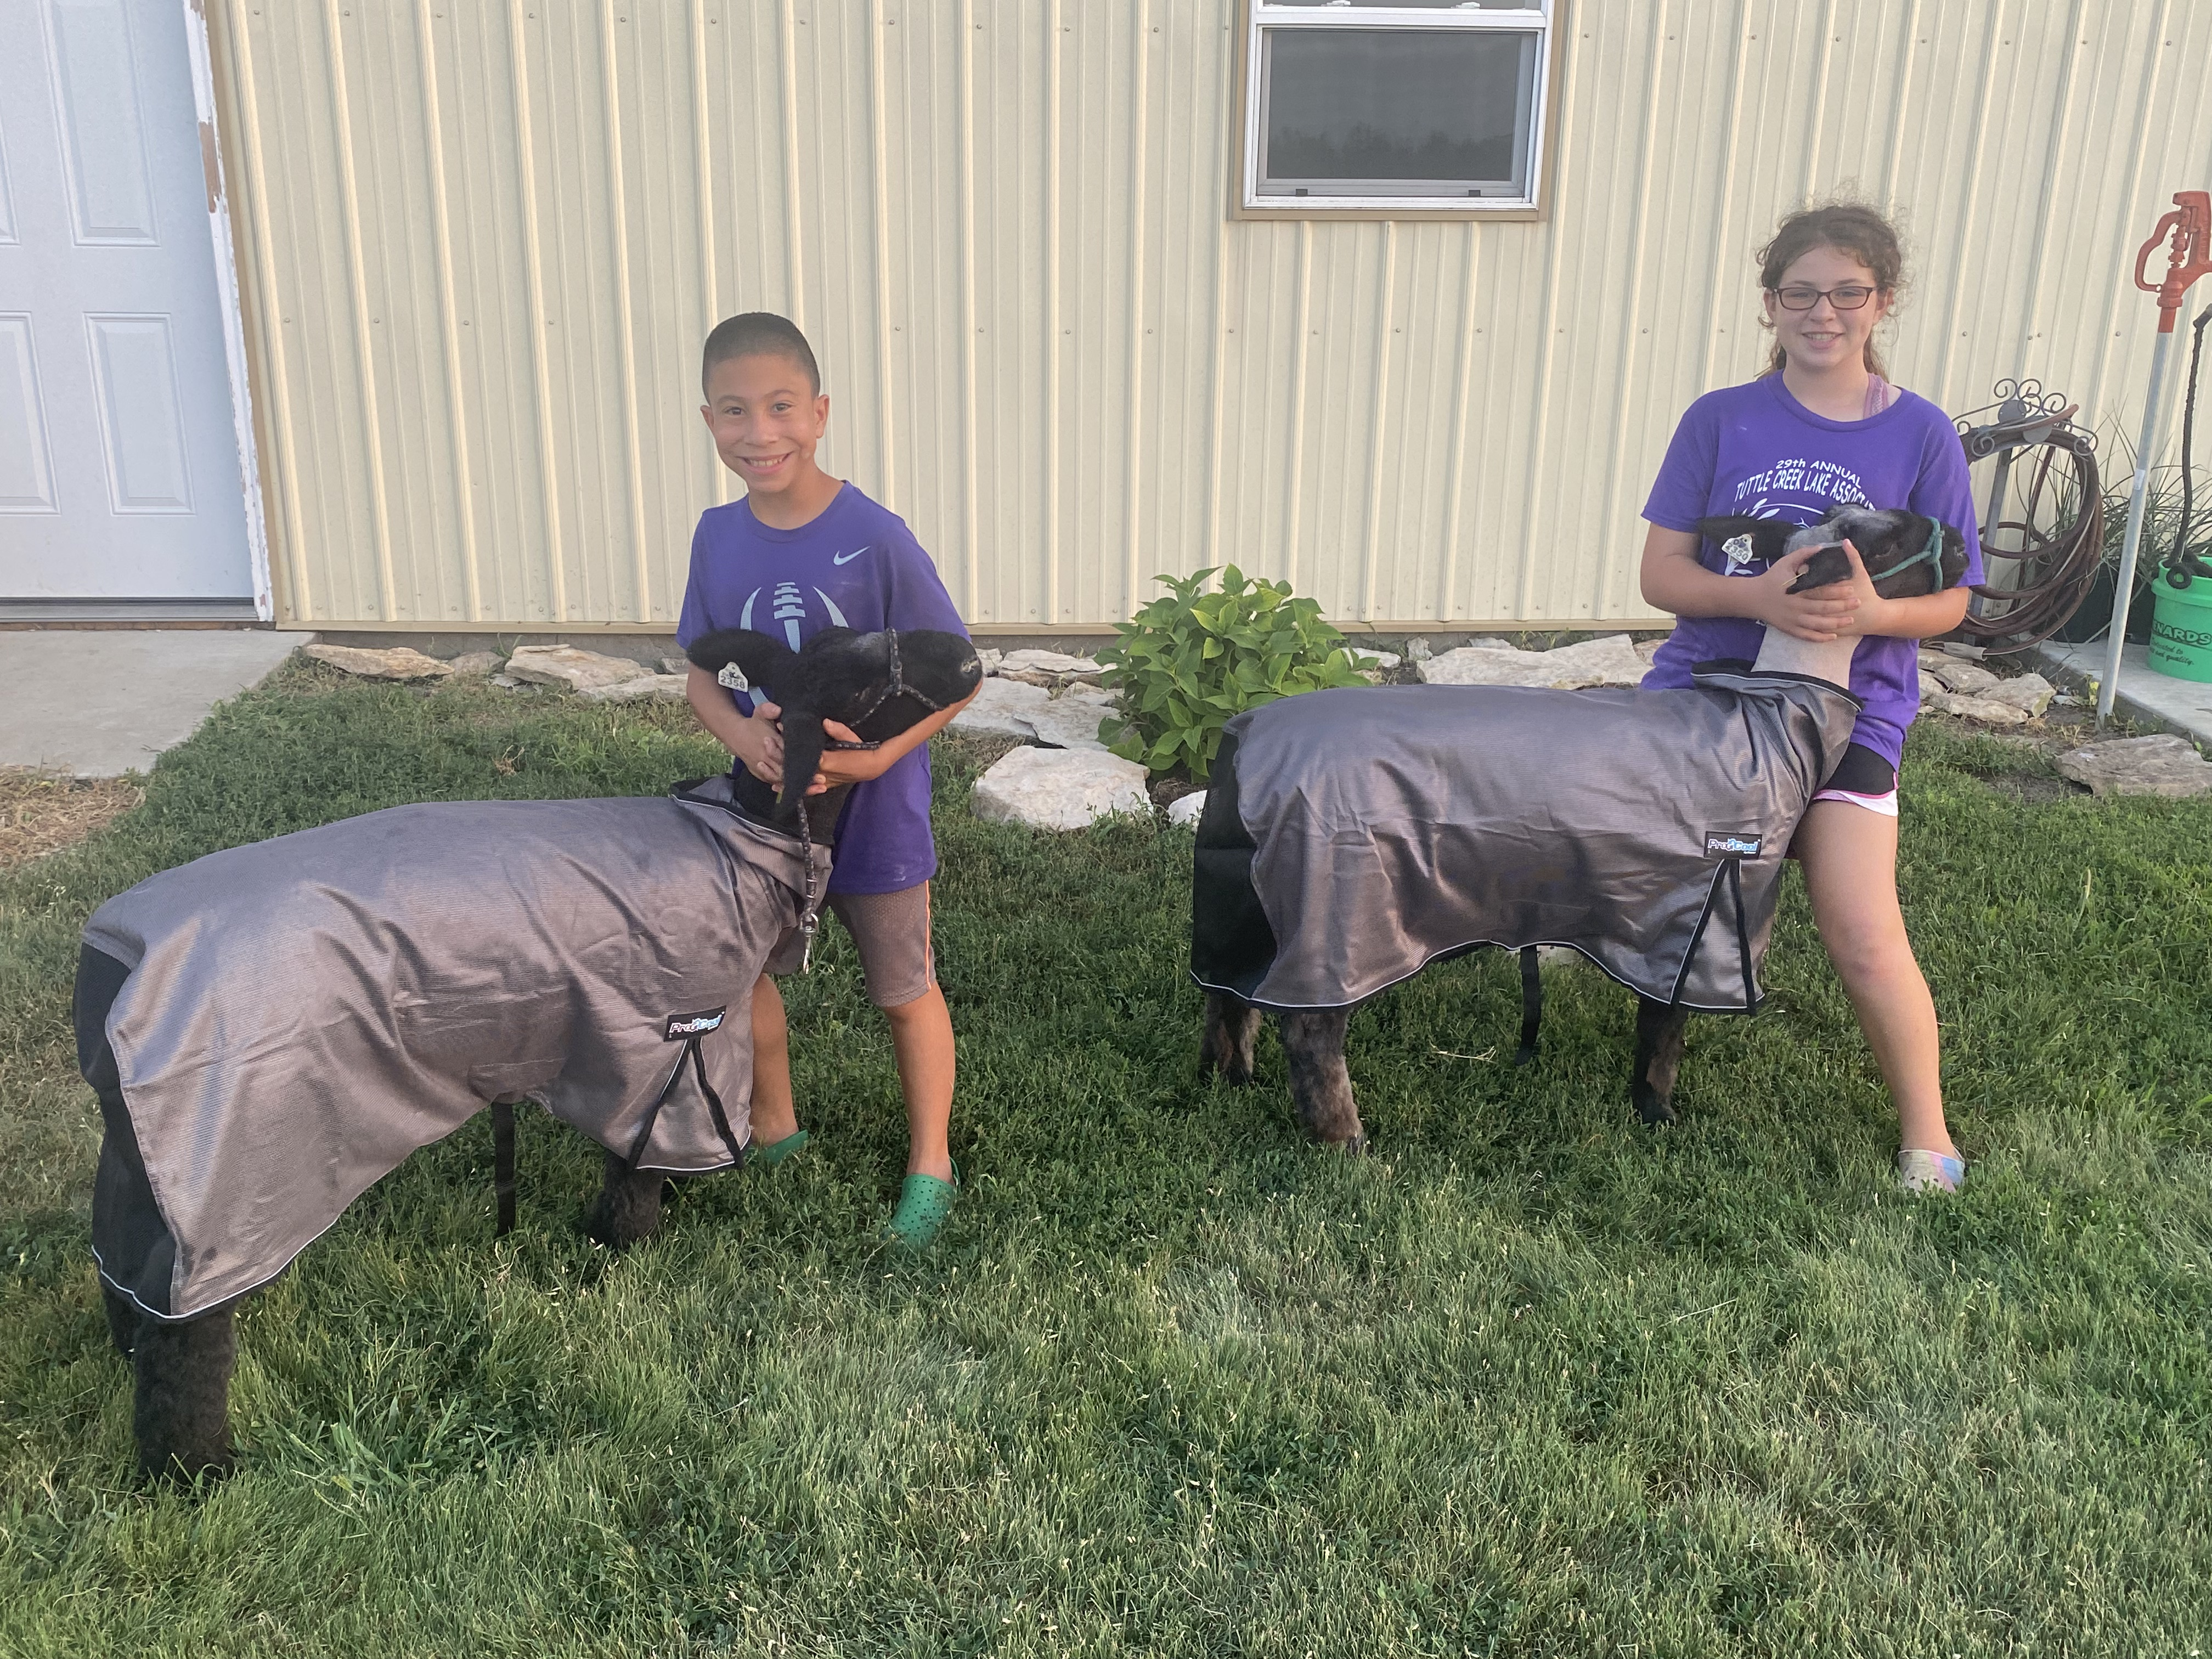
My Family

Slide 9
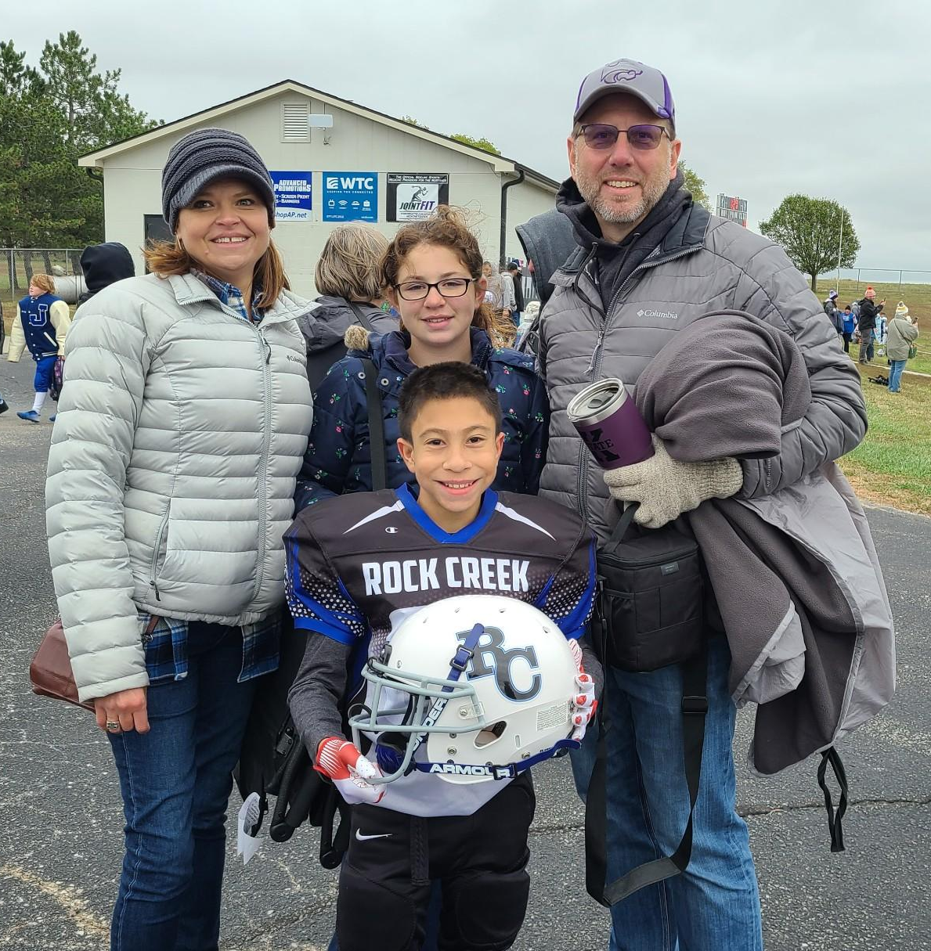

Slide 10
What is in the box?

Slide 11
Support - 2
Faculty
  Agricultural Communications – 6
  Agricultural Education – 6
  Agricultural Leadership – 3
  4H and Extension - 4
Teaching Assistants
  Agricultural Communications – 8
  Agricultural Education – 5
  Agricultural Leadership – 3

Slide 12
Programs Offered
Bachelor’s Degrees
  Agricultural Communications
  Agricultural Communications: Agribusiness Double Major
  Agricultural Communications: Animal Science Double Major
  Agricultural Education: Multidisciplinary
  Agricultural Leadership
  Agricultural Leadership: Extension Education
  Agricultural Leadership: International Studies

Slide 13
Programs Offered
Master’s Degrees
  Agricultural Communications, MS
  Agricultural Education, MS
  Agricultural Leadership, MAG
PhD
  Agricultural Education

Slide 14
Follow the plan

Slide 15
The numbers the way I see them
Agricultural Communications
  Spring ‘23 – 34 graduates
  Fall ‘22 – 14 graduates
  Spring ‘22 – 34 graduates
  Fall ‘21 – 18 graduates
  Spring ‘21 – 35 graduates

Slide 16
The numbers the way I see them
Agricultural Education
  Spring ‘23 – 22 graduates
  Fall ‘22 – 10 graduates
  Spring ‘22 – 21 graduates
  Fall ‘21 – 6 graduates
  Spring ‘21 – 27 graduates

Slide 17
The numbers the way I see them
Agricultural Leadership
  Spring ‘23 – 25 graduates
  Fall ‘22 – 9 graduates
  Spring ‘22 – 15 graduates
  Fall ‘21 – 4 graduates
  Spring ‘21 – 18 graduates

Slide 18
The numbers the way I see them
PhD in Agricultural Education
  Spring ‘23 – 0 graduates
  Fall ‘22 – 0 graduates
  Spring ‘22 – 2 graduates
  Fall ‘21 – 1 graduate
  Spring ‘21 – 3 graduates

Slide 19
The numbers the way I see them
Master of Science
  Spring ‘23 – 7 graduates
  Fall ‘22 – 8 graduates
  Spring ‘22 – 14 graduates
  Fall ‘21 – 1 graduate
  Spring ‘21 – 11 graduates

Slide 20
Think Different?

Slide 21
Questions to Ponder
Do we have the right number of students?
  Are we meeting the demand?
Do we have the right number of faculty?
  Do we have capacity?
What additional support do our students need?

Slide 22
Undergraduate Programming
Non-Formal Education
  Minor?
  Certificate?
Distance Education
  Undergraduate Programs?
Scholarships

Slide 23
Graduate Programming
PhD
  Does the name represent the degree?
  Can we open up the clientele?
Masters
  How do we increase student numbers?
  Can we increase the target learner?

Slide 24
Research
Increase Research Expenditures
  Add value to other programs
    We are educational and communication experts
  Lead collaborations
    We are leaders who can build teams
These can increase graduate students

Slide 25
Team
One department or three programs
  Collaboration
    Grants
    Programs
  Meetings
  Celebrations
  Social

