Slide 1
Vision for Developing a World Class Department of Agricultural Education, Communications and Leadership
J. Shane Robinson, PhD
Candidate for the Department Head Position
Department of Agricultural Education, Communication and Leadership
Oklahoma State University

Slide 2
Seminar Details
Plan for a 30-minute seminar
Share my background information of my career and experience in AECL and administration
Share my vision for opportunities in Oklahoma

Slide 3
Background Information
J. Shane Robinson, PhD
Candidate for the Department Head Position
Department of Agricultural Education, Communication and Leadership
Oklahoma State University

Slide 4
Hollis, OK

Slide 5
Hollis, OK

Slide 6
Robinson Durocs

Slide 7
Robinson Herefords

Slide 8
State FFA Degree – 1993

Slide 9
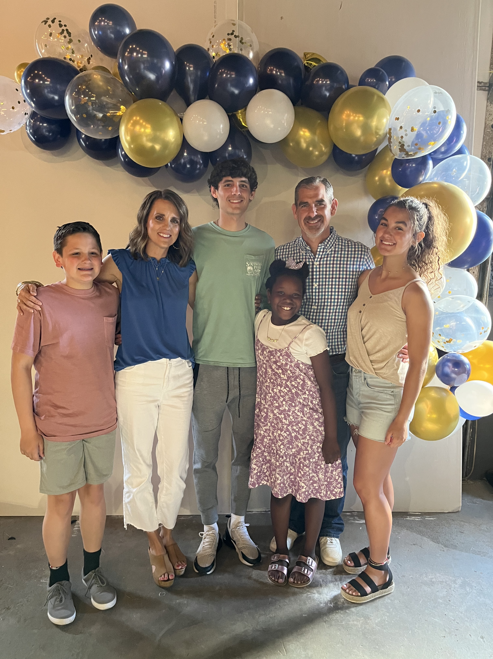
My Family

Slide 10
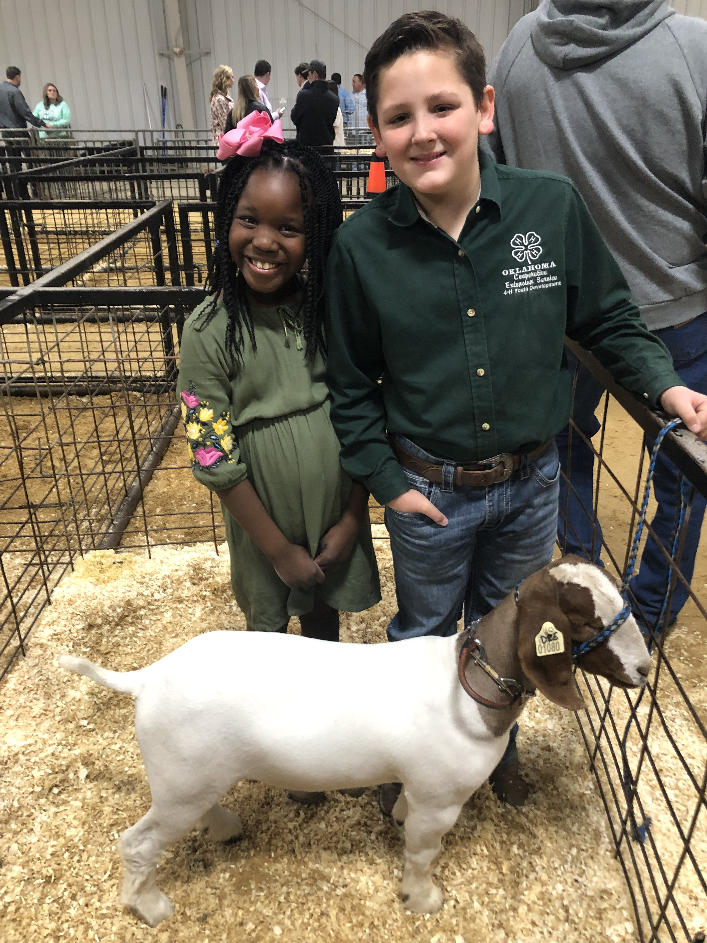
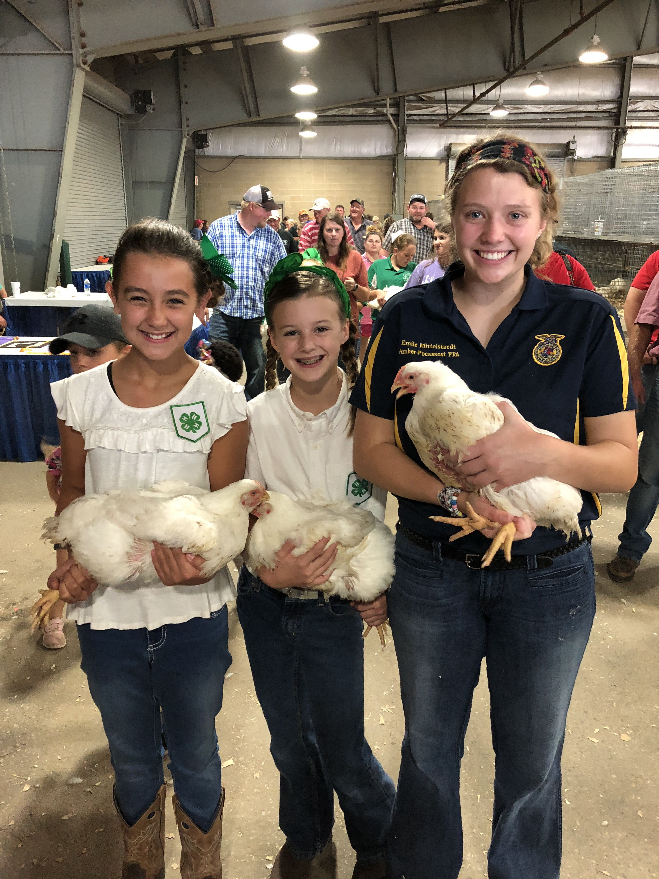
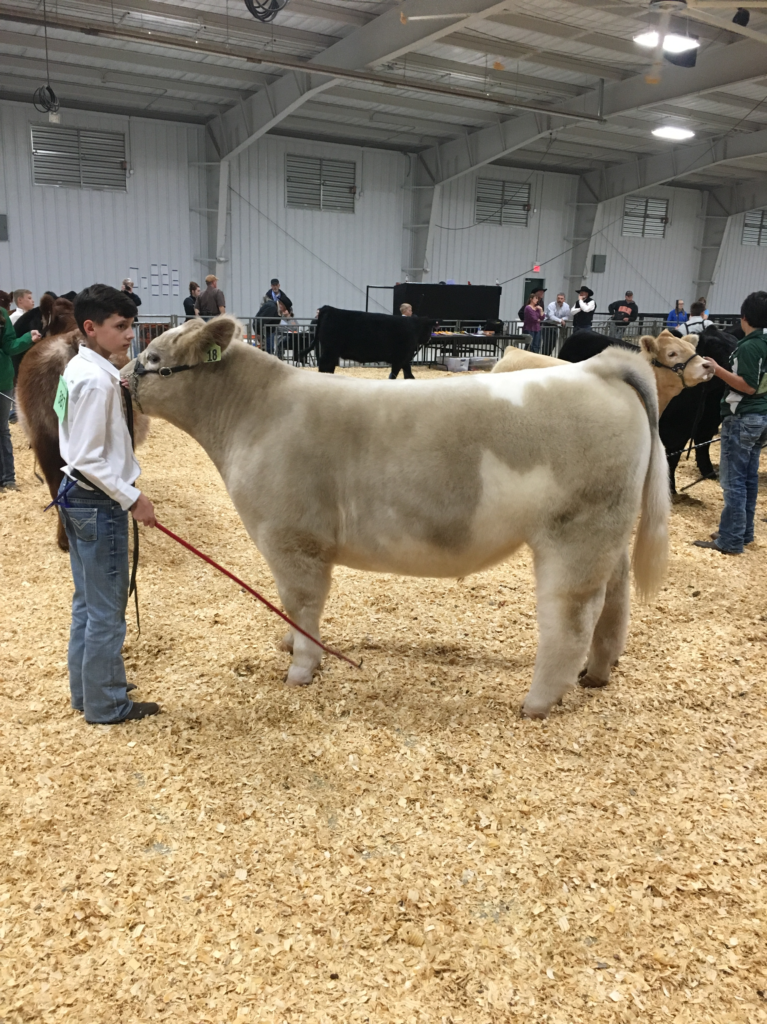
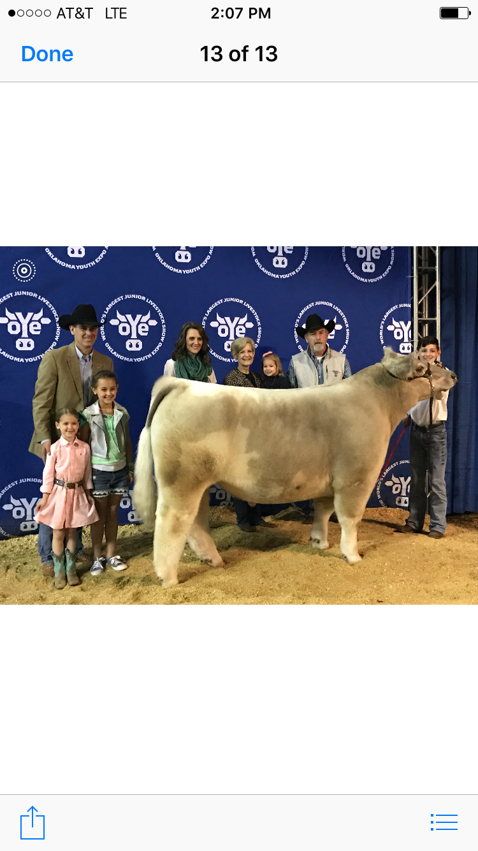
Family Photos

Slide 11
My Career Experience in AECL and Administration
J. Shane Robinson, PhD
Candidate for the Department Head Position
Department of Agricultural Education, Communication and Leadership
Oklahoma State University

Slide 12
Lasso

Slide 13
Lasso with Pistol Pete

Slide 14
Lasso with Pistol Pete and SC logo

Slide 15
Lasso with Pistol Pete, SC and Mizzou logos

Slide 16
Lasso with Pistol Pete, SC, Mizzou and UK logos

Slide 17
Select Leadership and Professional Highlights of 17 Years in the Professoriate
Published 92 journal articles (5.41 per year); 113 papers, 67 abstracts, 70 posters, and two book chapters
Served on 110 graduate committees; chaired 10 dissertations, 11 Master of Science, and 13 Master of Agriculture
Advised three Kahler AAAE Dissertation of the Year Awards
Presented over 130 workshops, professional development sessions, and guest lectures
Generated over $8 million in grant funding
Awarded the Regents Distinguished Teaching Award in 2017
Served as chair of the Agricultural Education Workgroup (10 years)
Co-Chaired AAAE Team 4: Increasing the Impact of Our Scholarship in 2017
Recognized as an AAAE Fellow in 2020
Chair-Elect of the AAAE
Served as Co-Director of the Rural Renewal Initiative (5 years)
Served as Associate Director of ITLE (10 years)

Slide 18
My Vision for Opportunities in Oklahoma
J. Shane Robinson, PhD
Candidate for the Department Head Position
Department of Agricultural Education, Communication and Leadership
Oklahoma State University

Slide 19
World Class – Merriam-Webster Dictionary
world-class
/ˌwər(ə)ldˈklas/
Adjective
(of a person, thing, or activity) of or among the best in the world.
Being of the highest caliber in the world.
“a world-class player”

Slide 20
Implications of Creating a World Class Department

Slide 21
World Class Teaching
Faculty who exhibit teaching excellence
A commitment to teaching resources and state-of-the-art laboratories
Courses that include high-impact learning experiences
An emphasis on student engagement and student success
Peer-coaching (i.e., lesson study) feedback loops
Team teaching and other collaborative teaching models
Active learning strategies
High-quality assessment strategies
A focus on the Scholarship of Teaching and Learning

Slide 22
World Class Teaching Goals
Develop a nationally recognized program for preparing agricultural educators (i.e., traditionally and alternatively certified teachers and nonformal educators)
Create a collaborative, peer-mentoring program among faculty
Reconsider course offerings based on advisory council, industry standards, and research
Ensure each course includes a high-impact learning experience
Deliver content through a variety of portals including in-person, online, digital games, and apps

Slide 23
World Class Extension
Faculty who value community engagement and outreach efforts
A willingness to extend research into counties and communities
Faculty who recognize the importance of a “programmatic effect” (i.e., extending terminal publications)
Programs that are impactful, sustainable, and solve relevant problems
A strong, working relationship with stakeholders and constituents
A focused preparation program for Extension educators
A focus on the Scholarship of Application

Slide 24
World Class Extension Goals
Extend each research study’s findings to the public where applicable
Establish strong working relations in all 77 counties
Create a nationally renowned nonformal preparation program
Develop and measure high-quality, problem-based programs and their impact on improving citizens’ overall wellbeing

Slide 25
World Class Research
Faculty who conduct relevant research to solve societal problems in Oklahoma, the United States, and across the world
Team-based, inter-, trans-, and multi-disciplinary collaboration, which includes the pairing of both social and technical sciences
Continuous stream of funding (both internal and external) to support faculty travel and graduate student stipends
A research profile that attracts additional, high-quality faculty scholars
Faculty with prolific research publication records
Faculty contributing to an established departmental research agenda
A focus on the Scholarship of Discovery

Slide 26
World Class Research Goals
Establish a sustainable, innovative, and impactful departmental research agenda
Create research studies that identify, address, and solve societal problems in agriculture
Establish a sustained level of funding to support high-impact research
Elevate the overall research profile of the department
Publish research in peer-reviewed journals

Slide 27
The Development of a Departmental Research Agenda

Slide 28
Departmental Research Agenda

Slide 29
Departmental Research Agenda
Departmental Mission and Vision Statements

Slide 30
Departmental Research Agenda
Departmental Mission and Vision Statements
Identification of the commonalities within each workgroup

Slide 31
Departmental Research Agenda
Departmental Mission and Vision Statements
Identification of the commonalities within each workgroup
Consensus on research focus across the department

Slide 32
Departmental Research Agenda
Departmental Mission and Vision Statements
Identification of the commonalities within each workgroup
Consensus on research focus across the department
Develop research objectives and aims that align with the President’s Strategic Plan and Priorities

Slide 33
Departmental Research Agenda
Departmental Mission and Vision Statements
Identification of the commonalities within each workgroup
Consensus on research focus across the department
Develop inter-, trans-, and multidisciplinary teams in each aim
Develop research objectives and aims that align with the President’s Strategic Plan and Priorities

Slide 34
Departmental Research Agenda
Departmental Mission and Vision Statements
Identification of the commonalities within each workgroup
Consensus on research focus across the department
Develop inter-, trans-, and multidisciplinary teams in each aim
Develop research objectives and aims that align with the President’s Strategic Plan and Priorities
Develop a conceptual framework of the research agenda and priorities therein

Slide 35
Departmental Research Agenda
Departmental Mission and Vision Statements
Identification of the commonalities within each workgroup
Consensus on research focus across the department
Use the conceptual framework to guide grant and research productivity
Develop inter-, trans-, and multidisciplinary teams in each aim
Develop research objectives and aims that align with the President’s Strategic Plan and Priorities
Develop a conceptual framework of the research agenda and priorities therein

Slide 36
Departmental Research Agenda
Departmental Mission and Vision Statements
Solve relevant, agricultural problems in Oklahoma, the United States, and across the world with a focus on OSU’s Strategic Plan and Priorities
Identification of the commonalities within each workgroup
Consensus on research focus across the department
Use the conceptual framework to guide grant and research productivity
Develop inter-, trans-, and multidisciplinary teams in each aim
Develop research objectives and aims that align with the President’s Strategic Plan and Priorities
Develop a conceptual framework of the research agenda and priorities therein

Slide 37
Oklahoma State University Priority Areas
Innovating to Nourish the World
1
Leading in Aerospace Innovation and Application
2
Enhancing Human and Animal Health (OneHealth)
3
Powering a Growing World Population Sustainably and Responsibly
4

Slide 38
ROPE
Recognizing Opportunities and Pursuing Excellence

Slide 39
Two Potential Partners
Hitching our Wagon to Existing Models of Excellence

Slide 40
Equipping Students to Address Wicked Problems in Rural Communities J. Shane Robinson, Tyson E. Ochsner, Paul Weckler, Mark Woodring
Livelihood outcomes
Reduced vulnerability
Increased health and well-being
Strengthened relationships and institutions
Better job and educational opportunities
Improved food and water security
Enhanced natural resource base
Natural
Livelihood strategies
Natural resource based
Non-natural resource based
Migration
Cultural
Built
Vulnerabilities
Trends
Shocks
Community
capitals
Influence
Institutions
Policies
Political
Financial
Processes
Social
Human
To learn more, visit:
ruralrenewal.okstate.edu
Resilience building
Part 1: Seed Projects
Solicit seed grants each fall
Scientists must visit communities prior to submitting
Community and scientific committees select finalists
Part 1: Seed Projects
Part 2: Rural Scholars Program
Part 3: Rural Renewal Symposium
Connect researchers, students, and community members
Award an annual Rural Renewal Research prize
Award an annual Rural Renewal Citizenship prize
Late October to early November
Part 2: Rural Scholars Program
Developing Rural Scholars for Civic and Community Engagement – a 16-week course taught in Spring semesters
10-week immersive summer research and service experiences in targeted rural communities
Part 3: Rural Renewal Symposium

Slide 41
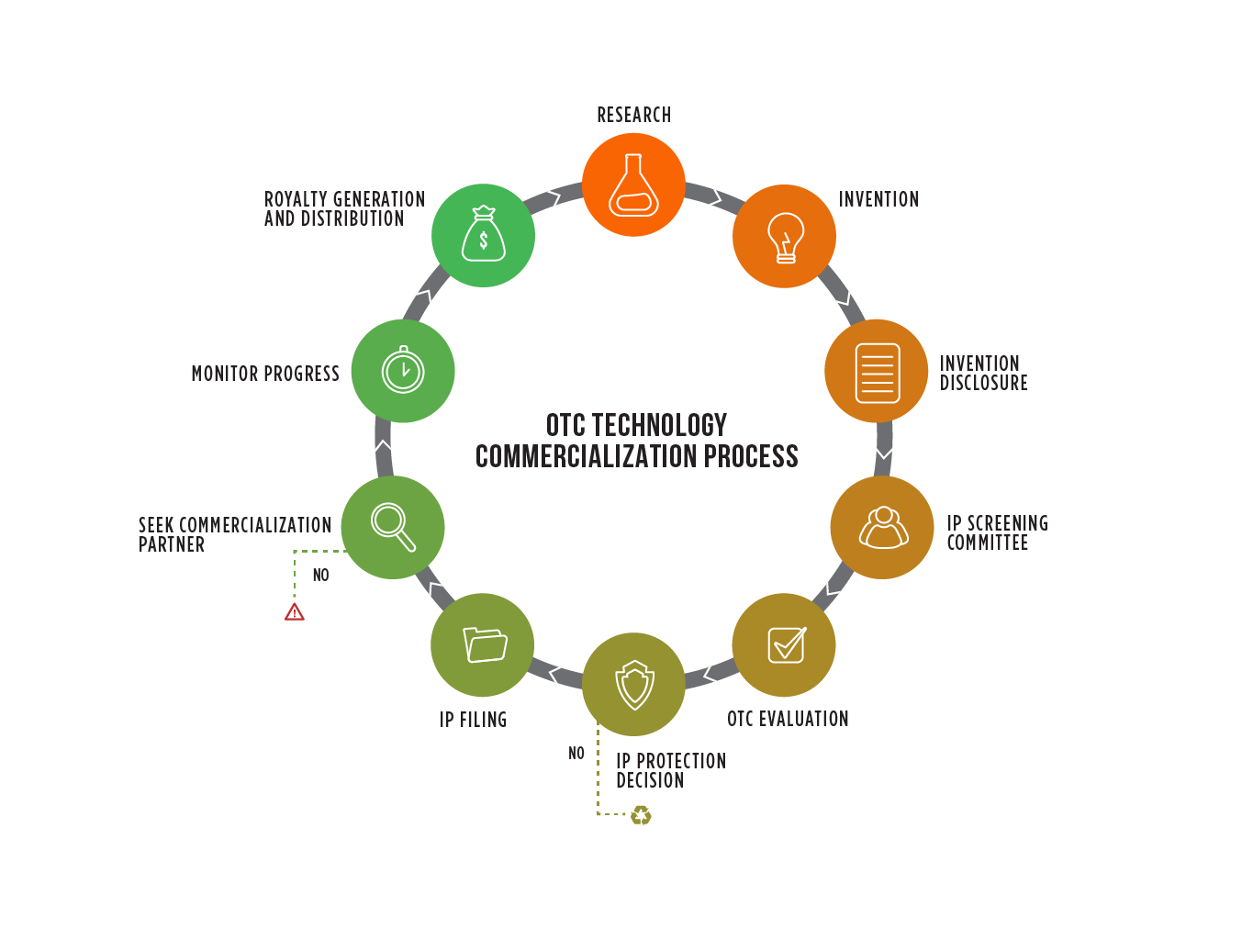
OSU Innovation Park
Technology Hub for High-Tech, Startup Companies
Transfer technology, knowledge, and discoveries to the general public.
Mission: To create an environment that stimulates innovation, attracts and builds corporations, and drives mutually beneficial engagements between OSU and industry, resulting in accelerated economic development and diversification.
EX: Community Food Systems, Rural Health

Slide 42
Departmental Research Agenda
Departmental Mission and Vision Statements
Solve relevant problems in Oklahoma, the United States, and across the world
Use the conceptual framework to guide grant and research productivity
Identification of the commonalities within each workgroup
Develop a Conceptual Framework to guide the research
Consensus on research foci across the department
Develop research objectives and aims that align with the President’s Strategic Plan
Develop inter-, trans-, and multidisciplinary teams in each aim

Slide 43
Thank you!
J. Shane Robinson, PhD
Candidate for the Department Head Position
Department of Agricultural Education, Communication and Leadership
Oklahoma State University

Slide 44
Vision for Developing a World Class Department of Agricultural Education, Communications and Leadership
J. Shane Robinson, PhD
Candidate for the Department Head Position
Department of Agricultural Education, Communication and Leadership
Oklahoma State University

